Slide 1
Team Fresh Air
Megan Thomas, Javier Ramirez, Chris Schertenlieb, and Tressa Groelsma

Slide 2
Overview - Our four main areas
Web App using Django framework
Amazon DynamoDB for air quality sensor data
Text/Email alert system
Data visualization

Slide 3
Intended Progress
Web app
Web Form / Form Submission to DB
Build page to display maps
Data Visualization
Find the best way to represent data
Display live maps on website with data pulled from DynamoDB
Data Cleaning/Handling
Perform data reduction techniques on available sensor data
Alert System
Create a table for customer info in DynamoDB and create a text alert script

Slide 4
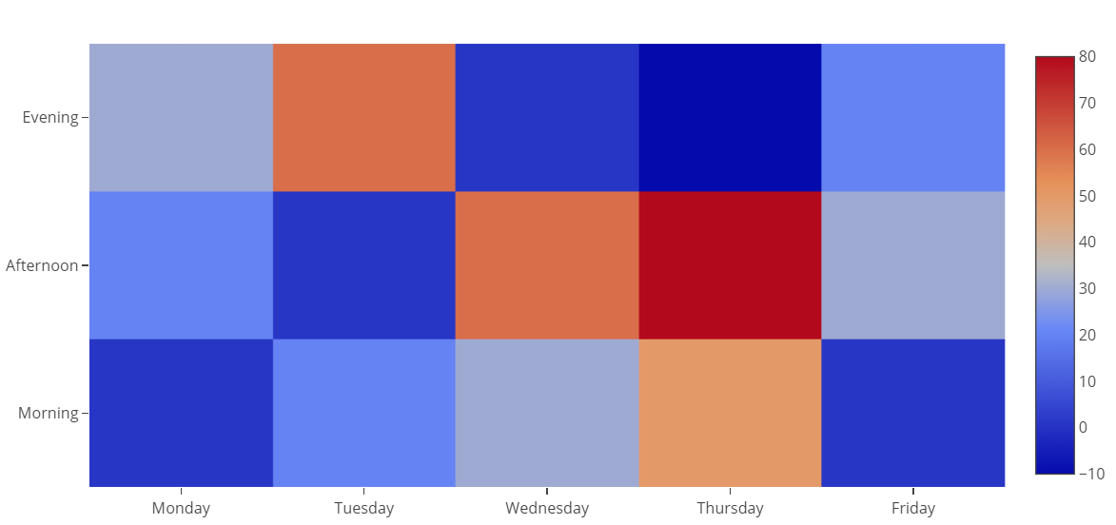
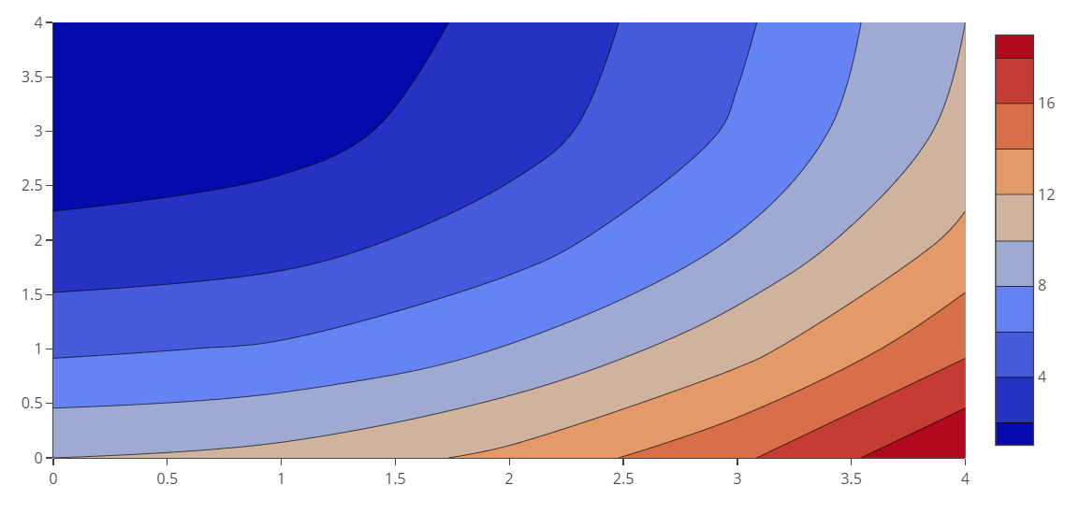
Research
Data visualization
Heat Map Contour Map

Slide 5
Progress Reflection
Web app
Completed Web App
Web App DB Submission
Built page for maps but unable to display
Data Visualization
Choropleth Map & Scatter Plot Map - Division by neighborhoods
Pulled data from DynamoDB
Displayed maps on site??
Data Cleaning/Handling
Alert System
Created the customer information table
created two texting script options to be asked about in sponsor meeting

Slide 6
Problems Encountered
Best route for texting API for further development
Finding best way to present data
Accurate representation
Understandable & user-friendly
Will display nicely on site
Difficult to integrate maps into Django views/templates

Slide 7
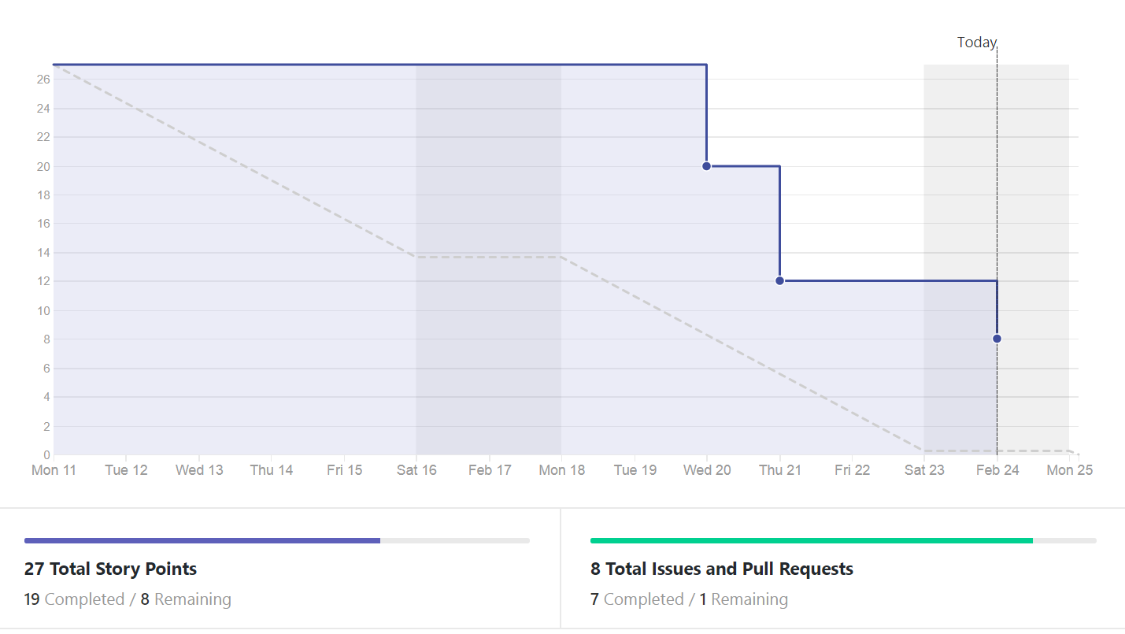
Burndown Chart

Slide 8
Demo Web App

Slide 9
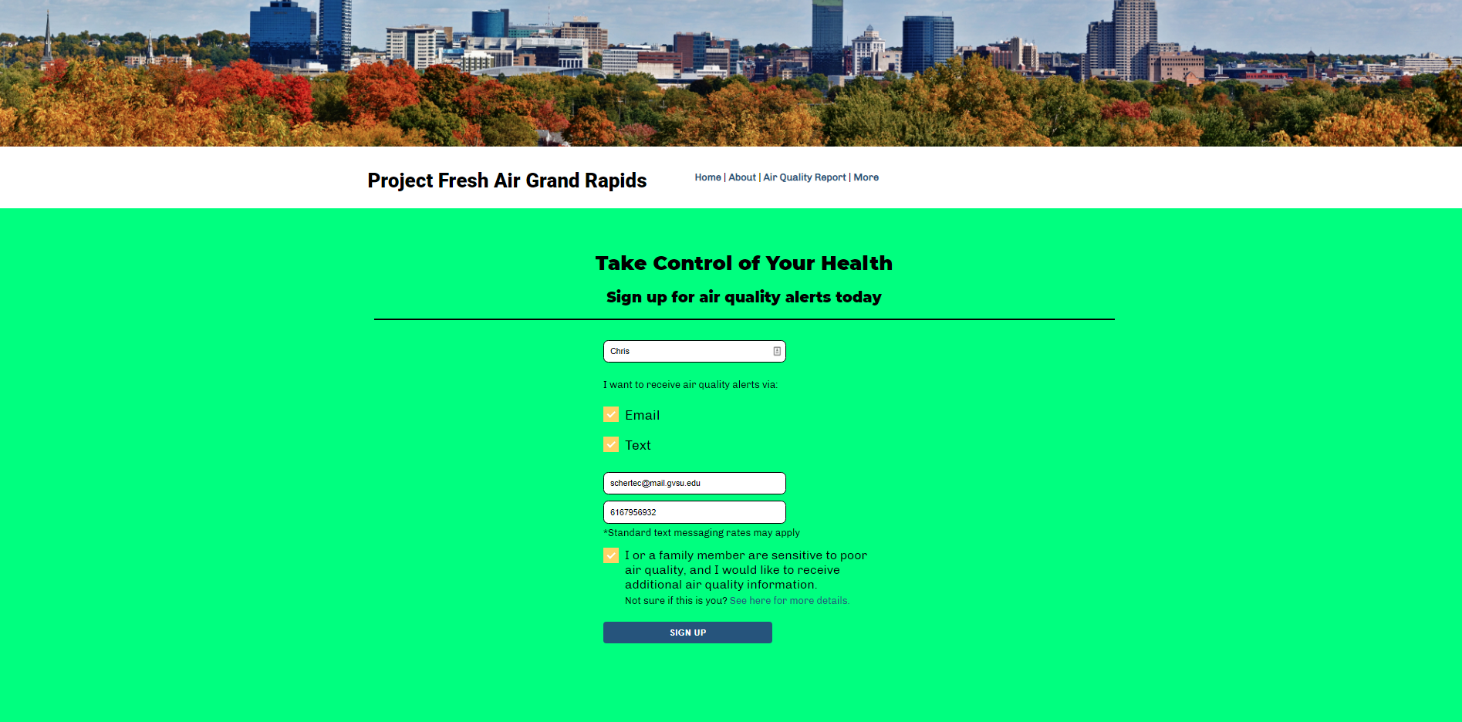

Slide 10
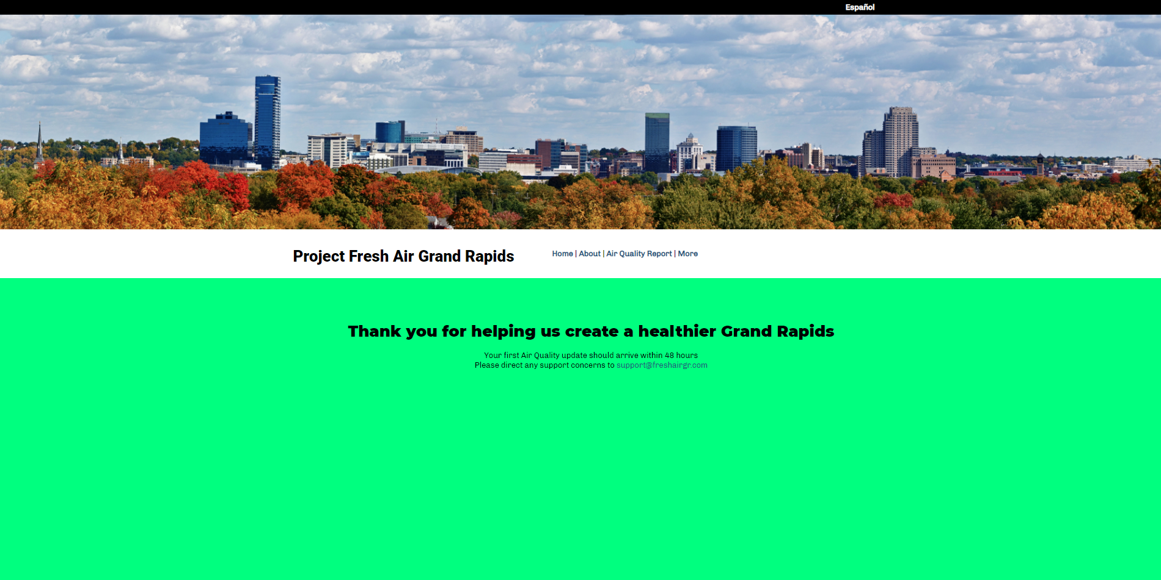

Slide 11
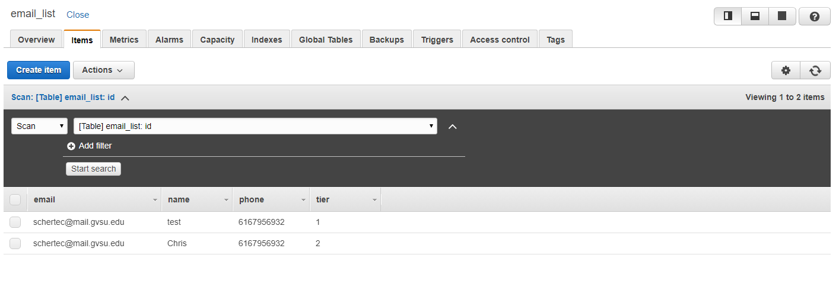

Slide 12
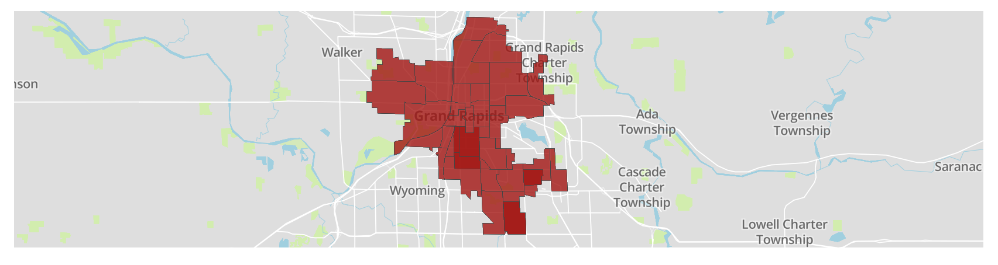
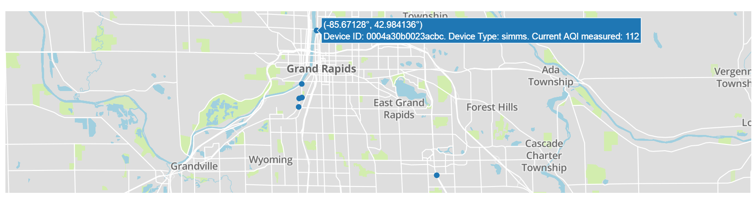

Slide 13
Projected Progress for Sprint 3
Get live data analyzed and ready to put on the website
Add a credentials file
Push notifications
Show live data on AQI map and create legend
Other minor site pages/designs
Air Quality Information Guide
About Page
CSV download page
Contact Us page

Slide 14
Conclusion

